Slide 1
Object Oriented Programming with C++
Prepared by
ALOK KUMAR
MCA-2012

Slide 2
Part – A 1. Overview of OOP

Slide 3
Object Oriented Paradigm
Software Evolution
Evolution of Programming Paradigm
- Monolithic
- Procedure Oriented Programming
- Structured Oriented Programming
- Object Oriented Programming

Slide 4
Structured Vs Object Oriented Programming
Function Oriented Object Oriented
Procedure Abstraction Procedure & Data abstraction
Does not support Supports External Interface External Interface
Free flow of Data Secured Data & not freely
flows
Also called FOP Also called OOP

Slide 5
Elements of OOP
Well suited for:
Modeling the real world problem as close as possible to the users perspective.
Interacting easily with computational environment.
Constructing reusable software components and easily extendable libraries.
Easily modifying and extending implementations of components without having to recode every thing from scratch.

Slide 6
Elements of OOP
Definition of OOP:
“Object oriented programming is a programming methodology that associates data structures with a set of operators which act upon it.”

Slide 7
Elements of OOP
Objects
Classes
Encapsulation
Data Abstraction
Inheritance
Polymorphism
Dynamic Binding
Message Passing

Slide 8
Objects
OOP uses objects as its fundamental building blocks.
Objects are the basic run-time entities in an object-oriented system.
Every object is associated with data and functions which define meaningful operations on that object.
Object is a real world existing entity.
Object is anInstance of a particular class.

Slide 9
Object
Operation
Operation
Attributes
Operation
Operation

Slide 10
Example: StudentObject
Enroll()
st_name
st_id
branch
semester
Performance()
Displayinfo()
Result()

Slide 11
Class
Class is a collection of similar objects.
Class

Slide 12
Encapsulation
“Mechanism that associates the code and the data it manipulates into a single unit and keeps them safe from external interference and misuse.”

Slide 13
Encapsulation
Class: student
Attributes: st_name, st_id,
branch, semester
Functions: Enroll()
Displayinfo()
Result()
Performance()

Slide 14
Data Abstraction
“A data abstraction is a simplified view of an object that includes only features one is interested in while hides away the unnecessary details.”
“Data abstraction becomes an abstract data type (ADT)or a user-defined type.”

Slide 15
C++ Implementation
class class_name
{
Attributes;//Properties
Operations;//Behaviours
};

Slide 16
C++ Implementation
class student
{
char st_name[30];
char st_id[10];
char branch[10];
char semester[10];
Void Enroll( );
Void Displayinfo( );
Voide Result( );
Void Performance( );
};
class stack
{
int stck[SIZE];
int tos;
void init();
void push(int i);
int pop();
};

Slide 17
Inheritance
“Inheritance is the mechanism to provides the power of reusability and extendibility.”
“Inheritance is the process by which one object can acquire the properties of another
object.”

Slide 18
Inheritance
Parent class
Or
Base class
Point
Child class
Or
Derived class
Line

Slide 19
Polymorphism
Polymorphism means that the same thing can exist in two forms.
“Polymorphism is in short the ability to call different functions by just using one type of function call.”

Slide 20
Polymorphism
5+9
Str + ing
+

Slide 21
Dynamic Binding
“ Dynamic Binding is the process of linking of the code associated with a procedure call at the run-time”.

Slide 22
Message Passing
“The process of invoking an operation on an object. In response to a message the corresponding method is executed in the object”.

Slide 23
Message Passing
StudentObject
FacultyObject
Performance
MgmtObject
Performance
Result

Slide 24
Object Oriented Languages
Object-Based programming Languages
Not support Inheritance & Dynamic Binding
Example: Ada
Object-Oriented programming Languages
Examples: Simula, Smalltalk80, Objective C, C++, Eiffel etc.,

Slide 25
2. C++ Overview

Slide 26
Structure of C++ Program
Include Files
Class Definition
Class Function Definition
Main Function Program

Slide 27
Simple C++ Program
// Hello World program
#include <iostream.h>
int main() {
cout << "Hello World\n";
return 0;
}
comment
Allows access to an I/O library
Starts definition of special function main()
output (print) a string
Program returns a status code (0 means OK)

Slide 28
Preprocessing
Temporary file
(C++ program)
C++
Preprocessor
C++
Compiler
C++ Program
Executable
Program

Slide 29
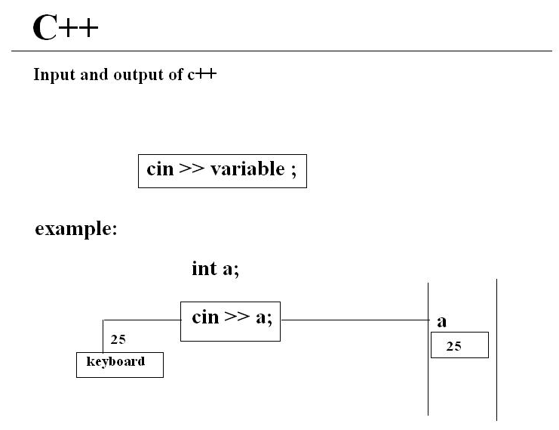

Slide 30
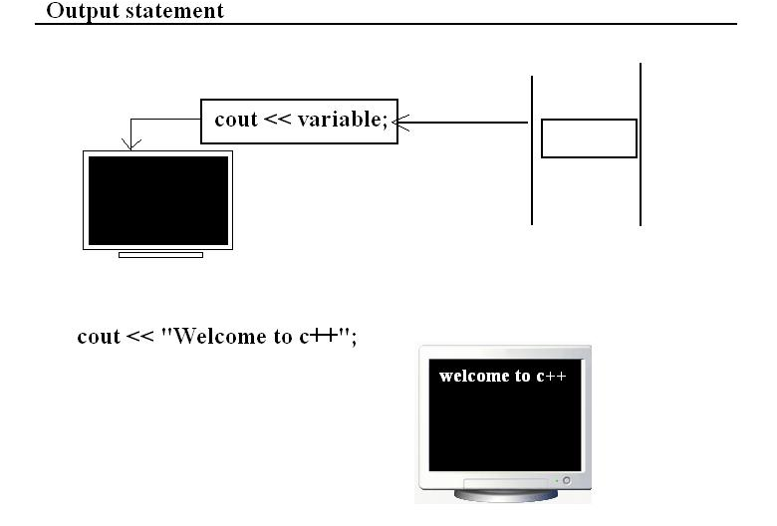

Slide 31
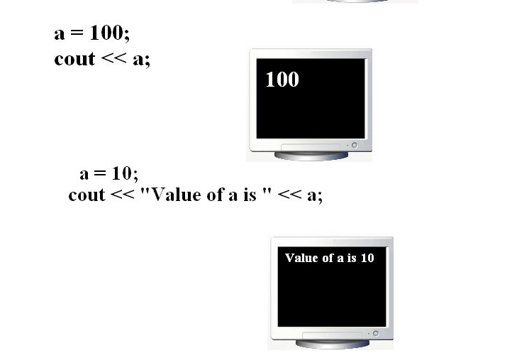

Slide 32
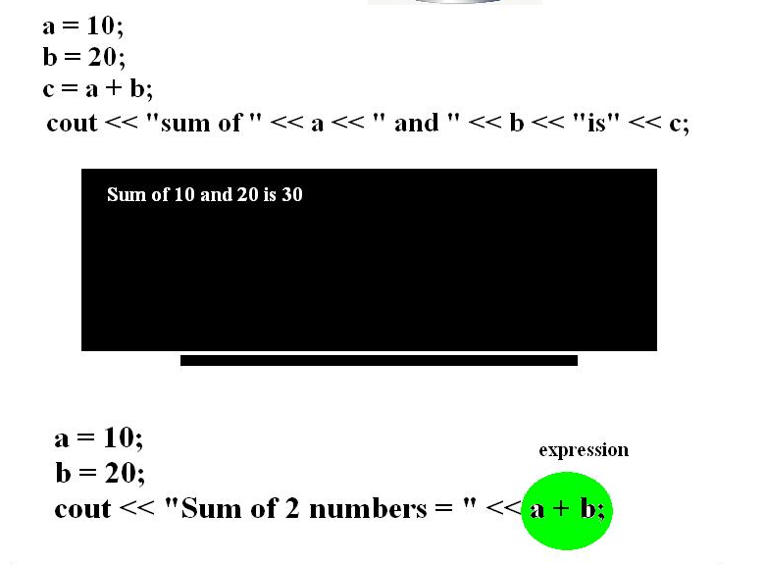

Slide 33
C++ LANGUAGE
C++ Program is a collection of
Tokens
Comments
White Space

Slide 34
C++ TOKENS
RESERVED KEYWORDS
IDENTIFIERS
LITERALS
OPERATORS
SEPARATORS

Slide 35
RESERVED KEYWORDS
Has predefined functionality
C++ has 48 keywords
Written in only in lower case

Slide 36
RESERVED KEYWORDS
delete | boolean | Break | Enum
case | volatile | Catch | Char
const | continue | Default | Do
else | asm | Extern | Union
float | for | Auto | Unsigned
if | inline | Register | Class
int | template | Long | Double
virtual | operator | Signed | goto
Protected | public | Sizeof | Return
Static | Struct | this | new
Friend | Throw | Typedef | private
try | Switch | while | short

Slide 37
IDENTIFIERS
Programmer-designed tokens
Meaningful & short
Long enough to understand
C++ rules for Identifiers
- alphabets, digits, underscore
- should not start with digits.
- Case sensitive
- Unlimited length
- Declared anywhere

Slide 38
LITERALS
Sequence of char. that represents constant values to be stored in variables
C++ literals are:
- Integer literals: 1,2,456,0xffff
- Floating_point literals: 4.67,3.14E-05
- Charater literals: ‘A’, ‘B’
- String literals: “ABC”, “TOTAL”

Slide 39
LITERALS (Symbolic Constants)
Using const qualifier
ex: const int size=10;
Using enum keyword
ex: enum{X,Y,Z};
defines const X=0;
defines const Y=0;
defines const Z=0;

Slide 40
OPERATORS
Is a symbol that takes more than one operands & operates on them to produce a result.
- Arithmetic
- Relational
- Logical
- Assignment
- increment/Decrement
- conditional
- scope resolution(::)
- special operators: new, delete, endl, setw

Slide 41
SEPARATORS
Symbols used to indicate where groups of code are divided & arranged
C++ separators:
()parentheses .. Methods, precedence in exp
{} braces .. Arrays init., block of codes, scopes
; semicolon
,comma.. Separate multiple identifiers, chain more than one stmt
. Period.. Data members, methods
[]Brackets.. Array referencing/dereferencing

Slide 42
C++ STATEMENTS
C++ stmts
Exp
stmt
Labelledstmt
Guarding stmt
Control
stmt
Selection stmt
Iteration stmt
Jump stmt
If
If
else
switch
while
do
for
break
continue
return

Slide 43
Arrays in C++
An array is a consecutive group of memory locations.
An array is a collection of similar data elements.

Slide 44
Memory and Arrays
Each int is 2 bytes
16 bits
a[0]
a[1]
int a[6];
a[5]

Slide 45
Array Initialization
We can initialize an array :
int a[5] = { 1,8,3,6,12};
double d[2] = { 0.707, 0.707};
char s[] = { 'R', 'P', 'I' };
NOTE:
Need not have to specify a size when initializing,
the compiler will count automatically.

Slide 46
An array printing function
Can pass an array as a parameter.
Need not have to say how big it is!
void print_array(int a[], int len)
{
for (int i=0;i<len;i++)
cout << "[" << i << "] = "
<< a[i] << endl;
}
Notes:
On the course home page in code/arrays/printarray.cpp

Slide 47
Arrays of char are special
C++ provides a special way to deal with arrays of characters:
char str[] = “C++ char Arrays";
char arrays can be initialized with string literals.

Slide 48
2-D Array: int A[3][4]
 | Col 0 | Col 1 | Col 2 | Col 3
Row 0 | A[0][0] | A[0][1] | A[0][2] | A[0][3]
Row 1 | A[1][0] | A[1][1] | A[1][2] | A[1][3]
Row 2 | A[2][0] | A[2][1] | A[2][2] | A[2][3]

Slide 49
2-D Memory Organization
{
A[0][0]
A[0][1]
A[0][2]
A[1][0]
A[1][1]
A[1][2]
A[2][0]
A[2][1]
A[2][2]
A[3][0]
A[3][1]
A[3][2]
char A[4][3];
A[0]
A[1]
A[2]
A[3]
{
A is an array of size 4.
Each element of A is
an array of 3 chars
{
{

Slide 50
2-D Array
Need not have to specify the size of the first dimension
But must include all other sizes!
double student_average( double g[][NumHW], int stu)
{
double sum = 0.0;
for (int i=0;i<NumHW;i++)
sum += g[stu][i];
return(sum/NumHW);
}
Notes:
Available via the course home page in code/arrays/2darray.cpp

Slide 51
C++ Strings
Supports C-String
C++ defines a string class called string
The string class supports several constructors. The prototypes of commonly used one is
string( );
ex: string str("Alpha");

Slide 52
C++ Strings
Operator Meaning
= Assignment
+ Concatenation
+= Concatenation assignment
== Equality
!= Inequality
< Less than
<= Less than or equal
> Greater than
>= Greater than or equal
>> Reads
<< Prints

Slide 53
C++ Strings
str2 = str1; // assigning a string
str3 = str1 + str2; //concatenating strings
if(str2 > str1) cout<<” str2 is bin“;//compares
str1 = "This is a null-terminated string.\n";
cin>>str1; //reads
Cout<<str1; //prints

Slide 54
3. Modular Programming with Functions

Slide 55
Modular Programming
“The process of splitting of a large program into small manageable tasks and designing them independently is known as Modular Programming or Divide-&-Conquer Technique.”

Slide 56
C++ Functions
“Set of program statements that can be processed independently.”
Like in other languages, called subroutines or procedures.

Slide 57
Advantages …?
Elimination of redundant code
Easier debugging
Reduction in the Size of the code
Leads to reusability of the code
Achievement of Procedure Abstraction

Slide 58
Function Components
Function Prototypes
Function Definition(declaration & body)
Function Parameters(formal parameters)
return statement
Function call(actual parameters)

Slide 59
Sample function
Formal parameters
Return type
Function name
int add_int(int a, int b)
{
return(a+b);
}
Function body

Slide 60
Using Math Library functions
C++ includes a library of Math functions that we use.
We have to know how to call these functions before we use them.
We have to know what they return.
We don’t have to know how they work!
#include <math.h>

Slide 61
Math Library Functions
ceil floor
cos sin tan
exp log log10 pow
Etc.,

Slide 62
Function parameters
The Formal parameters are local to the function.
When the function is called they will have the values passed in.
The function gets a copy of the values passed in.

Slide 63
Local variables
Parameters and variables declared inside the definition of a function are local.
They only exist inside the function body.
Once the function returns, the variables no longer exist!

Slide 64
Block Variables
We can also declare variables that exist only within the body of a compound statement
(a block):
{
int res;
…
…
}

Slide 65
Global variables
We can declare variables outside of any function definition – these variables are global variables.
Any function can access/change global variables.
Example: flag that indicates whether debugging information should be printed.

Slide 66
Scope
The scope of a variable is the portion of a program where the variable has meaning (where it exists).
A global variable has global (unlimited) scope.
A local variable’s scope is restricted to the function that declares the variable.
A block variable’s scope is restricted to the block in which the variable is declared.

Slide 67
Block Scope
int main(void)
{
int y;
{
int a = y;
cout << a << endl;
}
cout << a << endl;
}
Error – a doesn’t exist outside the block!

Slide 68
Nested Blocks
void example()
{
for (int j=0;j<10;j++)
{
int k = j*10;
cout << j << “,” << k << endl;
{
int m = j+k;
cout << m << “,” << j << endl;
}
}
}
j
k
m
Notes:
Available on the course home page in code/functions/blockscope.cpp

Slide 69
Storage Class
Each variable has a storage class.
Determines the life time during which the variable exists in memory.
Some variables are created only once
Global variables are created only once.
Some variables are re-created many times
Local variables are re-created each time a function is called.

Slide 70
Storage Classes
auto – created each time the block in which they exist is entered.
register – same as auto, but tells the compiler to make as fast as possible.
static – created only once, even if it is a local variable.
extern – global variable declared elsewhere.

Slide 71
Argument Passing
Pass by Value
Pass by Reference
Program to swap two numbers
Program to sort list of numbers

Slide 72
Inline Functions
“ Inline functions are those whose function body is inserted in place of the function call statement during the compilation process.”
Syntax:
inline return_dt func_name(formal parameters)
{
function body
}

Slide 73
Inline Functions
Frequently executed interface functions.
Expanding function calls inline can produce faster run times.
Like the register specifier, inline is actually just a request, not a command, to the compiler.

Slide 74
Inline Function
Pgm to find square of a given number using inline function
Pgm to implement queue with its basic operations: enqueue(), dequeue(), display() where queue_full() and queue_empty() are inline functions

Slide 75
Function Overloading
“ Multiple functions to share the same name with different signatures(types or numbers).”
int myfunc(int i)
{
return i;
}
int myfunc(int i, int j)
{
return i*j;
}

Slide 76
Function Templates
“A generic function defines a general set of operations that will be applied to various types of data.”
A single general procedure can be applied to a wide range of data.

Slide 77
Function Templates
Syntax:
template <class Ttype> ret-type func-name( parameter list)
{
// body of function
}

Slide 78
Function Templates
Pgm to sort integer list and float list using function template
Pgm to add matrix elements using function template (for both int and double matrix)
Pgm to find sum of a given list(int and float)using functoin template
Pgm to implement integer and float stack using function template

Slide 79
Recursive Functions
Pgm to find Fibonacci sequence upto n number
Pgm to simulate Tower of Hanoi
Pgm to add array of integers
Pgm to multiply two natural numbers
Pgm to find factorial of a given number

Slide 80
4. Classes & Objects

Slide 81
Introduction
The New C++ Headers(New style)
#include<iostream>
using namespace std;
The old style Headers
#include<iostream.h>

Slide 82
The New C++ Headers
A namespace is simply a declarative region.
The purpose of a namespace is to localize the names of identifiers to avoid name collisions.
iostream, math, string, fstream etc., forms the contents of the namespace called std.

Slide 83
Class Specification
Syntax:
class class_name
{
};
Data members
Members functions

Slide 84
Class Specification
class Student
{
int st_id;
char st_name[];
void read_data();
void print_data();
};
Data Members or Properties of Student Class
Members Functions or Behaviours of Student Class

Slide 85
Class Specification
Visibility of Data members & Member functions
public - accessed by member functions and all
other non-member functions in the
program.
private - accessed by only member functions of the
class.
protected - similar to private, but accessed by
all the member functions of
immediate derived class
default - all items defined in the class are private.

Slide 86
Class specification
class Student
{
int st_id;
char st_name[];
void read_data();
void print_data();
};
private / default
visibility

Slide 87
Class specification
class Student
{
public:
int st_id;
char st_name[];
public:
void read_data();
void print_data();
};
public visibility

Slide 88
Class Objects
Object Instantiation:
The process of creating object of the type class
Syntax:
class_name obj_name;
ex: Student st;
Creates a single object of the type Student!
St_id, St_name
void read_data( )
void print_data( )

Slide 89
Class Object
More of Objects
ex: Student st1;
Student st2;
Student st3;

Slide 90
Class Objects
10,Rama
20, Stephen
void read_data( )
void read_data( )
void print_data( )
void print_data( )
st1
st2
55, Mary
void read_data( )
void print_data( )
st3

Slide 91
Class Objects
33, Joseph
S[0]
S[1]
S[2]
S[3]
S[4]
S[5]
S[6]
S[7]
Array of Objects
ex: Student s[8];
void read_data( )
void print_data( )
St[0]
24, Sakshi
void read_data( )
void print_data( )
St[4]

Slide 92
Accessing Data Members (outside the class)
Syntax: (single object)
obj_name . datamember;
ex: st.st_id;
Syntax:(array of objects)
obj_name[i] . datamember;
ex: st[i].st_id;

Slide 93
Accessing Data Members (inside the class member function)
Syntax: (single object)
data_member;
ex: st_id;
Syntax:(array of objects)
data_member;
ex: st_id;

Slide 94
Defining Member Functions
Syntax :(Inside the class definition)
ret_type fun_name(formal parameters)
{
function body
}

Slide 95
Defining Member Functions
Syntax:(Outside the class definition)
ret_type class_name::fun_name(formal parameters)
{
function body
}

Slide 96
Accessing Member Functions
Syntax: (single object)
obj_name . Memberfunction(act_parameters);
ex: st.read( );
Syntax:(array of objects)
obj_name[i] . Memberfunction(act_parameters);
ex: st[i].read( );

Slide 97
Data Hiding
“Data hiding is the mechanism of implementation details of a class such a way that are hidden from the user.”
The concept of restricted access led programmers to write specialized functions for performing the operations on hidden members of the class.

Slide 98
Data Hiding
Read_data()
private:
st_name
st_id
branch
semester
Cal_best()
Print_data()
Result()

Slide 99
Data Hiding
The access specifier acts as the key strength behind the concept of security.
Provides access to only to the member functions of class. Which prevents unauthorized access.

Slide 100
Data Hiding
Advantages:
Makes Maintenance of Application Easier
Improves the Understandability of the Application
Enhanced Security

Slide 101
Inline Functions with Class
Syntax :(Inside the class definition)
inline ret_type fun_name(formal parameters)
{
function body
}

Slide 102
Inline Functions with Class
Syntax:(Outside the class definition)
inline ret_type class_name::fun_name (formal parameters)
{
function body
}

Slide 103
Inline Functions with Class
When to use Inline Function…..?
If a function is very small.
If the time spent to function call is more than the function body execution time.
If function is called frequently.
If fully developed & tested program is running slowly.

Slide 104
Constructors
“A constructor function is a special function that is a member of a class and has the same name as that class, used to create, and initialize objects of the class.”
Constructor function do not have return type.
Should be declared in public section.

Slide 105
Constructors
Example:
class student
{ int st_id;
public:
student()
{
st_id=0;
}
};
Synatax:
class class_name
{
public:
class_name();
};

Slide 106
Constructors
How to call this special function…?
class student
{
int st_id;
public:
student()
{
st_id=0;
}
};
int main()
{
student st;
…………
…………
};

Slide 107
Constructors
Pgm to create a class Addition to add two integer values. Use constructor to initialize values.
Pgm to create a class Circle to compute its area. Use constructor to initialize the data members.

Slide 108
Types of Constructors
Parameterized constructors
Overloaded constructors
Constructors with default argument
Copy constructors
Dynamic constructors

Slide 109
Parameterized Constructors
class Addition
{
int num1;
int num2;
int res;
public:
Addition(int a, int b); // constructor
void add( );
void print();
};
Constructor with parameters B’Coz it’s also a function!

Slide 110
Overloaded Constructors
class Addition
{
int num1,num2,res;
float num3, num4, f_res;
public:
Addition(int a, int b); // int constructor
Addition(float m, float n); //float constructor
void add_int( );
void add_float();
void print();
};
Overloaded Constructor with parameters B’Coz they are also functions!

Slide 111
Constructors with Default Argument
class Addition
{
int num1;
int num2;
int res;
public:
Addition(int a, int b=0); // constructor
void add( );
void print();
};
Constructor with default parameter.

Slide 112
Copy Constructor
class code
{
int id;
public:
code() //constructor
{ id=100;}
code(code &obj) // constructor
{
id=obj.id;
}
};

Slide 113
Dynamic Constructors
class Sum_Array
{
int *p;
public:
Sum_Array(int sz) // constructor
{
p=new int[sz];
}
};

Slide 114
Destructors
“A destructor function is a special function that is a member of a class and has the same name as that class used to destroy the objects.”
Must be declared in public section.
Destructor do not have arguments & return type.
NOTE:
A class can have ONLY ONE destructor

Slide 115
Destructors
Synatax:
class class_name
{
public:
~class_name();
};
Example:
class student
{
public:
~student()
{
cout<<“Destructor”;
}
};

Slide 116
Programs for Implementation
Pgm to create a class Complex to add two complex numbers using parmeterized constructor.
Pgm to create a class Complex to add two complex numbers using copy constructor.
Pgm to create a class Complex to add dynamically created integer to a complex number using Dynamic constructor.

Slide 117
Local Classes
“A class defined within a function is called Local Class.”
void fun()
{
class myclass {
int i;
public:
void put_i(int n) { i=n; }
int get_i() { return i; }
} ob;
ob.put_i(10);
cout << ob.get_i();
}
Syntax:
void function()
{
class class_name
{
// class definition
} obj;
//function body
}

Slide 118
Multiple Classes
Synatax:
class class_name1
{
//class definition
};
class class_name2
{
//class definition
};
Example:
class test
{
public:
int t[3];
};
Example:
class student
{ int st_id;
test m;
public:
viod init_test()
{
m.t[0]=25;
m.t[1]=22;
m.t[2]=24;
}
};

Slide 119
Nested Classes
Synatax:
class outer_class
{
//class definition
class inner_class
{
//class definition
};
};
Example:
class student
{ int st_id;
public:
class dob
{ public:
int dd,mm,yy;
}dt;
void read()
{
dt.dd=25;
dt.mm=2;
dt.yy=1988;}
};

Slide 120
Program for Implemention
Pgm to create a class STUDENT with properties: id, name, semester & three TEST marks(which should be defined as a separate class suitable properties) . The behaviors of the STUDENT should include:
1. To read the data
2. To Calculate average of best two
test marks
3. To print the data

Slide 121
Program for Implementation
Pgm to create a class EMPLOYEE with properties: id, name, designation & date of birth as DOB (which should be defined as inner class with suitable properties) . The behaviors of EMPLOYEE should include:
1. To read the data
2. To Calculate age
3. To print the data

Slide 122
Static Data Members
Static data members of a class are also known as "class variables“.
Because their content does not depend on any object.
They have only one unique value for all the objects of that same class.

Slide 123
Static Data Members
Tells the compiler that only one copy of the variable will exist and all objects of the class will share that variable.
Static variables are initialized to zero before the first object is created.
Static members have the same properties as global variables but they enjoy class scope.

Slide 124
Static Data Member
10, John
20, Shilpa
void read_data( )
void read_data( )
void print_data( )
void print_data( )
emp1
emp2
static int emp_seq;
55, Mohn
void read_data( )
void print_data( )
emp3

Slide 125
Static Member Functions
Member functions that are declared with static specifier.
Synatax:
class class_name
{
public:
static ret_dt fun_name(formal parameters);
};

Slide 126
Static Member Functions
Special features:
They can directly refer to static members of the class.
They does not have this pointer.
They cannot be a static and a non-static version of the same function.
The may not be virtual.
Finally, they cannot be declared as const or volatile.

Slide 127
Scope Resolution Operator
int i; // global i
void f()
{
int i; // local i
i = 10; // uses local i
.
.
.
}
?
int i; // global i
void f()
{
int i; // local i
::i = 10; // now refers to global i
.
.
.
}
Solution…..

Slide 128
Scope Resolution Operator
The :: operator links a class name with a member name in order to tell the compiler what class the member belongs to.
Has another related use:
Allows to access to a name in an enclosing scope that is "hidden" by a local declaration of the same name.

Slide 129
5. Objects with Functions

Slide 130
Passing Objects as Arguments
Objects are passed to functions through the use of the standard call-by-value mechanism.
Means that a copy of an object is made when it is passed to a function.

Slide 131
Object Assignment
Only
If Instances of same
Class!!
20, Shilpa
20, Shilpa
=
void read_data( )
void read_data( )
void print_data( )
void print_data( )
emp1
emp2

Slide 132
Passing Objects as Arguments
class complex
{
……
.…..
void Add(int x, complex c);
……
……
};
void main()
{
complex obj, s1;
……
……
……
obj.Add(6, s1) ;
……
……
}

Slide 133
Returning Objects
A function may return an object to the caller.
class complex
{
……
.…..
complex Add(int x, complex c);
……
……
};
void main()
{
complex obj, s1;
……
……
……
obj=obj.Add(6, s1) ;
……
……
}

Slide 134
Program for Implementation
Pgm to create class PAPER with its properties: width & height. Find the characteristics of a magzine Cover: width, height, perimeter and Area using passing object as argument(s) .

Slide 135
Friend Functions
“Friend function is a non-member function which can access the private members of a class”.
To declare a friend function, its prototype should be included within the class, preceding it with the keyword friend.

Slide 136
Friend Functions
Example:
class myclass
{
int a, b;
public:
friend int sum(myclass x);
void set_val(int i, int j);
};
Syntax:
class class_name
{
//class definition
public:
friend rdt fun_name(formal parameters);
};

Slide 137
Friend Functions
Advantages…?
When we overload operators.
When we create I/O overloaded functions.
When two or more classes members are interrelated and to carry out the communication to other parts of the program.

Slide 138
Program for Implementation
Pgm to create a class ACCOUNTS with function read() to input sales and purchase details. Create a Friend function to print total tax to pay. Assume 4% of profit is tax.

Slide 139
Friend Classes
“A class can be a friend of another class, allowing access to the protected and private members of the class in which is defined.”
Friend class and all of its member functions have access to the private members defined within the that class.

Slide 140
Friend Classes
Friend class Declaration
class Bclass
{
public :
:
void fn1(Aclass ac)
{
Bvar = ac. Avar;
}
private :
int Bvar;
};
class Aclass
{
public :
:
friend class Bclass;
private :
int Avar;
};

Slide 141
Program for Implementation
Program to create a class MinValue, is a friend of class TwoVaules contains two private members a and b. Where minimum() is a member function of MinValue that finds out the minimum of two values by accessing data members of class TwoValue. Initialize the values for two integer numbers through constructor.

Slide 142
Arrays of Objects
Several objects of the same class can be declared as an array and used just like an array of any other data type.
The syntax for declaring and using an object array is exactly the same as it is for any other type of array.

Slide 143
Class Objects
33, Joseph
S[0]
S[1]
S[2]
S[3]
S[4]
S[5]
S[6]
S[7]
Array of Objects
ex: Student s[8];
void read_data( )
void print_data( )
St[0]
24, Sakshi
void read_data( )
void print_data( )
St[4]

Slide 144
Program for Implementation
Pgm to create a class STUDENT with properties: rollno, name, IAmarks for 6 subjects, EndExamMarks for 6 subjects. Create function read() to read the details of student, calc_percent() to calculate the percentage marks for each student and show() to display the details of all students. Assume the following things to calculate percentage:
Total_sub_marks = IAmarks + EndExamMarks
& Total_marks = Addition of Total_sub_marks of 6 subjects.

Slide 145
Dynamic Objects
“ Dynamic objects are objects that are created / Instantiated at the run time by the class”.
They are Live Objects, initialized with necessary data at run time.
Its life time is explicitly managed by the program(should be handled by programmer).

Slide 146
Dynamic Objects
The new operator is used to create dynamic objects.
The delete operator is used to release the memory allocated to the dynamic objects.
NOTE:
C++ does not have Default Garbage Collector.

Slide 147
Pointers to Objects
student st;
51, Rajesh
student *ptr;
void read_data( )
ptr = & st;
void print_data( )
st
2FCD54
ptr

Slide 148
Pointers to Objects
“Pointers can be defined to hold the address of an object, which is created statically or dynamically”.
33, Joseph
Statically created object:
student *stp;
stp = &st;
void read_data( )
void print_data( )
Dynamically created object:
student *stp;
stp = new student;
st
2FCDA4

Slide 149
Pointers to Objects
Accessing Members of objects:
Syntax:
ptr_ob j → member_name;
ptr_obj → memberfunction_name( );
Example:
stp → st_name;
stp → read_data ( );

Slide 150
The this Pointer
“The this pointer points to the object that invoked the function”.
When a member function is called with an object, it is automatically passed an implicit argument that is a pointer to the invoking object (that is, the object on which the function is called).

Slide 151
The this Pointer
Accessing Members of objects:
Syntax:
obj . memberfunction_name( );
Example:
st . read_data ( );
this pointer points to st object

Slide 152
Program for Implementation
Pgm to find factorial of a number using this pointer.
Pgm to generate Fibonacci sequence upto nth value using this pointer.

Slide 153
Pointer to Class Member
d_ptr
51, Rajesh
void read_data( )
f_ptr
void print_data( )
st
2FCD54

Slide 154
Pointer to Class Member
“A special type of pointer that "points" generically to a member of a class, not to a specific instance of that member in an object”.
Pointer to a class member is also called pointer-to-member.

Slide 155
Pointer to Class Member
It provides only an offset into an object of the member's class at which that member can be found.
Member pointers are not true pointers, the . and -> cannot be applied to them.
A pointer to a member is not the same as a normal C++ pointer.

Slide 156
Pointer to Class Member
To access a member of a class:
special pointer-to-member operators
.*
–>*

Slide 157
Pointer to Class Member
Syntax to create pointer to data member
of a class:
Data_type class_name ::* data_member_ptr;
int student::*d_ptr;
Syntax to create pointer to member function
of a class:
rtn_dt (class_name::* mem_func_ptr)(arguments);
int (student::*f_ptr)();

Slide 158
Programs for Implementation
Pgm to find number of vowels in a given string using pointer to class members.
Pgm to find square of a given number if it is even else compute its cube, using pointer to class members.

Slide 159
Operator Overloading
“Operator overloading is the ability to tell the compiler how to perform a certain operation when its corresponding operator is used on one or more variables.”
Operator overloading is closely related to function overloading.
Allows the full integration of new class types into the programming environment.

Slide 160
Operator Overloading
Overloading of operators are achieved by creating operator function.
“An operator function defines the operations that the overloaded operator can perform relative to the class”.
An operator function is created using the keyword operator.

Slide 161
Operator Overloading
Operator functions can be either members or nonmembers of a class.
Non-member operator functions are always friend functions of the class.

Slide 162
Operator Overloading
Overloadable operators are:
+ - * / = < > += -= *= /= << >>
<<= >>= == != <= >= ++ -- % & ^
! | ~ &= ^= |= && || %= [] ()
new delete

Slide 163
Operator Overloading
Creating a Member Operator Function
Within Class:
ret-type operator#(argument-list);
Outside Class:
ret-type class-name::operator#(arg-list)
{
// operations
}

Slide 164
Operator Overloading
Example:
comp comp::operator+(comp op2 )
{
comp temp;
temp.real = op2.real + real;
temp.img = op2.img + img;
return temp;
}

Slide 165
Operator Overloading
Implicitly passed by this pointer
Explicitly passed argument
ob1 = ob1 + ob2;
ob1 = ob1.operator+ (ob2);

Slide 166
Operator Overloading Restrictions
Should not alter the precedence of an operator.
Should not change the number of operands that an operator takes.
Operator functions cannot have default arguments.
Operators cannot be overloaded are:
. : : .* ?: sizeof

Slide 167
Why not . : : .* ?: sizeof() operators?
The restriction is for safety. If we overload . operator then we cant access member in normal way.
The :? takes 3 argument rather than 2 or 1. There is no mechanism available by which we can pass 3 parameter during operator overloading.

Slide 168
Why not . : : .* ?: sizeof() operators?
Example:
c = a+b - both a & b actually refer to some memory location, so "+" operator can be overloaded,
but the "." operator, like a.i actually refers to the name of the variable from whom the memory location has to be resolved at time and thus it cannot be overloaded.

Slide 169
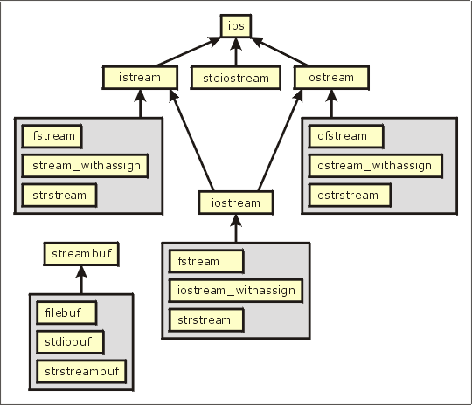
I/O Stream Class Hierarchy

Slide 170
Overloading >>
Prototype:
friend istream& operator >>(istream&, Matrix&);
Example:
istream& operator >>(istream& in, Matrix& m)
{
for(int i=0; i<row*col; i++)
{
in >> Mat[i];
}
return in;
}
void main()
{
:
Cin>>mobj;
:
}

Slide 171
Overloading <<
Prototype:
friend ostream& operator <<(ostream&, Matrix&);
Example:
ostream& operator <<(ostream& out, Matrix& m)
{
for(int i=0; i<row; ++i)
{
for(int j=0; j<col; j++)
{ out>> Mat[i][j] >> “\t” ; }
out << endl;
}
void main()
{
:
cout<<mobj;
:
}

Slide 172
Program for Implementation
Pgm to create a class Matrix assuming its properties and add two matrices by overloading + operator. Read and display the matrices by overloading input(>>) & output(<<) operators respectively.
Pgm to create a class RATIONAL with numerator and denominator as properties and perform following operations on rational numbers.
- r = r1 * r2; (by overloading * operator)
- To check equality of r1 and r2 (by overloading == operator)

Slide 173
6. Inheritance & Virtual Functions

Slide 174
Inheritance
“Inheritance is the mechanism to provides the power of reusability and extendibility.”
“Inheritance is the process by which one object can acquire the properties of another object.”
“Inheritance is the process by which new classes called derived classes are created from existing classes called base classes.”
Allows the creation of hierarchical classifications.

Slide 175
Inheritance
Parent class
Or
Base classc
Point
Child class
Or
Derived class
Line

Slide 176
Inheritance
Fruit
Orange
Mango
Banana

Slide 177
Inheritance
Super class
Polygon
Subclass
Subclass
Triangle
Rectangle

Slide 178
Inheritance
Polygon
Super class
Subclass1
Triangle
RightAngle
Triangle
Subclass2

Slide 179
Base Class
“Base class is a class which defines those qualities common to all objects to be derived from the base.”
The base class represents the most general description.
A class that is inherited is referred to as a base class.

Slide 180
Derived Class
“The classes derived from the base class are usually referred to as derived classes.”
“A derived class includes all features of the generic base class and then adds qualities specific to the derived class.”
The class that does the inheriting is called the derived class.

Slide 181
Inheritance
Note:
Derived class can be used as a base class for another derived class.
In C++, inheritance is achieved by allowing one class to incorporate another class into its declaration.

Slide 182
Inheritance
Syntax:
class derived_class: Acesss_specifier base_class
{ };
Example:
class CRectangle: public Cpolygon{ };
class CTriangle: public Cpolygon{ };

Slide 183
Inheritance & Access Specifier
Access | public | protected | private
Members of the same class | Yes | Yes | Yes
Members of derived classes | Yes | Yes | No
Non-members | Yes | No | No

Slide 184
Public base class Inheritance
All public members of the base class become public members of the derived class.
All protected members of the base class become protected members of the derived class.

Slide 185
Private base class Inheritance
All public and protected members of the base class become private members of the derived class.
But private members of the base class remain private to base class only, not accessible to the derived class.

Slide 186
Protected Members of Base Class
Member is not accessible by other non member elements of the program.
The base class' protected members become protected members of the derived class and are, therefore, accessible by the derived class.

Slide 187
Protected Base-Class Inheritance
All public and protected members of the base class become protected members of the derived class.
All public members of the base class become unavailable to main() function.
All private members of the base class become unavailable to the derived class.

Slide 188
Inheritance & Access Specifier
Access | public | protected | private
Members of the same class | Yes | Yes | Yes
Members of derived classes | Yes | Yes | No
Non-members | Yes | No | No

Slide 189
Inheriting Multiple Base Classes
Syntax:
class derived: Acess_specifier base1,
Acess_specifier base2
{ };
Example:
class Orange: Acess_specifier Yellow,
Acess_specifier Red
{ };

Slide 190
Inheriting Multiple Base Classes
Base class1
Base class2
Yellow
Red
Subclass
Orange

Slide 191
Constructors, Destructors & Inheritance
Constructor functions are executed in their order of derivation.
Destructor functions are executed in reverse order of derivation.

Slide 192
Inheritance
Fruit
Mango
Malgoba
Mango
Mallika
Mango

Slide 193
Constructors, Destructors & Inheritance
When an object of a derived class is created,
if the base class contains a constructor, it will be called first, followed by the derived class' constructor.
When a derived object is destroyed, its destructor is called first, followed by the base class' destructor.

Slide 194
Passing Parameters to Base-Class Constructors
Making use of an expanded form of the derived class's constructor declaration, we can pass arguments to one or more base-class constructors.
Syntax:
derived-constructor(arg-list) : base1(arg-list),
base2(arg-list), … baseN(arg-list)
{ // body of derived constructor }

Slide 195
Passing Parameters to Base-Class Constructors
As we are arguments to a base-class constructor are passed via arguments of the derived class' constructor.
Even if a derived class‘ constructor does not use any arguments, we need to declare a constructor as if the base class requires it.
The arguments passed to the derived class are simply passed along to the base class constructor.

Slide 196
Granting Access
When a base class is inherited as private:
- all public and protected members of that class become private members of the derived class.
But in some certain circumstances, we want to restore one or more inherited members to their original access specification.

Slide 197
Granting Access
To accomplish this :
using
access declaration

Slide 198
Granting Access
using statement:
is designed primarily to support namespaces.
Access declaration:
restores an inherited member's access specification
Syntax:
base_class_name::member;

Slide 199
Granting Access
Access declaration is done under the appropriate access heading in the derived class’ declaration.
Note:
No type declaration is required.

Slide 200
Granting Access
class base {
public:
int j;
};
class derived: private base {
public:
// here is access declaration
base::j;
};
public
public

Slide 201
Program for Implementation
Program to implement the given hierarchy assuming proper properties for student class. The Result class computes the result of every student. The Result_on_Web class displays the result upon getting the grant for USN.
student
private
Result
protected
Result_on_Web

Slide 202
Hierarchy of Classes
base
i
derived1
derived2
j
k
2 copies
derived12
i
j & k

Slide 203
Hierarchy of Classes
Remedy…..?
scope resolution operator
virtual base class

Slide 204
Virtual Base Classes
Used to prevent multiple copies of the base class from being present in an object derived from those objects by declaring the base class as virtual when it is inherited.
Syntax:
class derived : virtual public base
{ . . . };

Slide 205
Virtual Functions
“A virtual function is a member function that is declared within a base class and redefined by a derived class.”
Virtual functions implements the "one interface, multiple methods" philosophy under polymorphism.

Slide 206
Virtual Functions
The virtual function within the base class defines the form of the interface to that function.
Each redefinition of the virtual function by a derived class implements its operation as it relates specifically to the derived class. That is, the redefinition creates a specific method.

Slide 207
Virtual Functions
To create a virtual function, precede the function‘s declaration in the base class with the keyword virtual.
Example:
class base {
public:
virtual void member_func(){ }
};

Slide 208
Virtual Functions
Base
Virtual function
Derived1
Derived2
override
override

Slide 209
Virtual Functions
When accessed "normally" virtual functions behave just like any other type of class member function.
But virtual functions’ importance and capacity lies in supporting the run-time polymorphism when they accessed via a pointer.

Slide 210
Virtual Functions
How to implement run-time polymorphism?
- create base-class pointer can be used to point
to an object of any class derived from that base
- initialize derived object(s) to base class object.
Based upon which derived class objects’ assignment to the base class pointer, c++ determines which version of the virtual function to be called. And this determination is made at run time.

Slide 211
Virtual Functions
The redefinition of a virtual function by a derived class appears similar to function overloading?
No
The prototype for a redefined virtual function must match exactly the prototype specified in the base class.

Slide 212
Virtual Functions
Restrictions:
All aspects of its prototype must be the same as base class virtual function.
Virtual functions are of non-static members.
Virtual functions can not be friends.
Constructor functions cannot be virtual.
But destructor functions can be virtual.
NOTE:
Function overriding is used to describe virtual function
redefinition by a derived class.

Slide 213
Destructor functions can be virtual?
Yes.
In large projects, the destructor of the derived class was not called at all.
This is where the virtual mechanism comes into our rescue. By making the Base class Destructor virtual, both the destructors will be called in order.

Slide 214
Function overriding
“A function overriding is a process in which a member function that is declared within a base class and redefined by a derived class to implement the "one interface, multiple methods" philosophy under polymorphism.”

Slide 215
Calling a Virtual Function Through a Base Class Reference
Since reference is an implicit pointer, it can be used to access virtual function.
When a virtual function is called through a base-class reference, the version of the function executed is determined by the object being referred to at the time of the call.

Slide 216
The Virtual Attribute Is Inherited
When a virtual function is inherited, its virtual nature is also inherited.
Base
Virtual function
Derived1
override
override
Derived2

Slide 217
Virtual Functions Are Hierarchical
Virtual functions are also hierarchical in nature.
This means that when a derived class fails to override a virtual function, then first redefinition found in reverse order of derivation is used.

Slide 218
Virtual Functions Are Hierarchical
Virtual function
Base
First redefintion
Derived1
override
NOT overrides
Derived2

Slide 219
Virtual Functions Are Hierarchical
First redefintion
Base
Virtual function
Derived1
Derived2
override
NOT overrides

Slide 220
Pure Virtual Functions
“A pure virtual function is a virtual function that has no definition within the base class.”
To declare a pure virtual function:
Syntax:
virtual rtype func-name(parameter-list) = 0;

Slide 221
Pure Virtual Functions
When a virtual function is made pure, any derived class must provide its definition.
If the derived class fails to override the pure virtual function, a compile-time error will result.
NOTE:
When a virtual function is declared as pure, then all derived classes must override it.

Slide 222
Abstract Classes
“A class that contains at least one pure virtual function then it is said to be abstract class.”
No objects of an abstract class be created.
Abstract class constitutes an incomplete type that is used as a foundation for derived. classes.

Slide 223
Using Virtual Functions
We can achieve the most powerful and flexible ways to implement the "one interface, multiple methods“.
We can create a class hierarchy that moves from general to specific (base to derived).

Slide 224
Using Virtual Functions
We can define all common features and interfaces in a base class.
Specific actions can be implemented only by the derived class.
We can add new case easily.

Slide 225
Early vs. Late Binding
“Early binding refers to events that occur at compile time.”
Early binding occurs when all information needed to call a function is known at compile time.
Examples :
function calls ,overloaded function calls, and overloaded operators.

Slide 226
Early vs. Late Binding
“Late binding refers to function calls that are not resolved until run time.”
Late binding can make for somewhat slower execution times.
Example:
virtual functions

Slide 227
7. IO Stream Library

Slide 228
Introduction
In C++ I/O system operates through streams.
I/O system provides a level of abstraction between the programmer and the device.
This abstraction is called a stream and the actual device is called a file.

Slide 229
Introduction
A stream is a logical device that either produces or consumes information.
A stream is linked to a physical device by the I/O system.
Standard C++ provides support for its I/O system in <iostream.h>

Slide 230
C++ Streams
Input Streams
Extracts from
Input stream
Input
device
Extracts from
Input stream
Program
Inserts
Into
output stream
Output Streams
Output
Device

Slide 231
I/O Stream Classes for console Operations
ios
istream
ostream
streambuf
iostream
istream_withassign
ostream_withassign
iostream_withassign

Slide 232
C++'s Predefined Streams
When a C++ program begins execution, four built-in streams are automatically opened.
Stream Meaning Default Device
cin Standard input Keyboard
cout Standard output Screen

Slide 233
Unformatted I/O
Input operator
Output operator
Overloading I/O Operator

Slide 234
Input Operator
Extraction operator:(>>)
float var;
cin >>var;
char line[20];
cin>>line;
get(), getline(),read()

Slide 235
Output Operator
Insertion Operator:(<<)
float var;
char line[20];
cout<< var<<line;
put(),putline(),write()

Slide 236
Overloading >> operator
Prototype:
friend istream& operator >>(istream&, Matrix&);
Example:
istream& operator >>(istream& in, Matrix& m)
{
for(int i=0; i<row*col; i++)
{
in >> Mat[i];
}
return in;
}
void main()
{
:
Cin>>mobj;
:
}

Slide 237
Overloading << operator
Prototype:
friend ostream& operator <<(ostream&, Matrix&);
Example:
ostream& operator <<(ostream& out, Matrix& m)
{
for(int i=0; i<row; ++i)
{
for(int j=0; j<col; j++)
{ out>> Mat[i][j] >> “\t” ; }
out << endl;
}
void main()
{
:
cout<<mobj;
:
}

Slide 238
Formatted I/O
There are three related but conceptually different ways that we can format data.
- directly accessing members of the ios class.
- using special functions called manipulators.
- user defined output functions

Slide 239
Formatting Using the ios Members
The ios class declares a bitmask enumeration called fmtflags in which the following set of format flags are defined.
To set a flag, the setf() function is used. This function is a member of ios.
Syntax: fmtflags setf(fmtflags flags);
example: stream.setf(ios::showpos);

Slide 240
Flag | Meaning
skipws | leading white-space characters are discarded when performing input on a stream
left | output is left justified.
right | output is right justified. Default is right justified.
internal | a numeric value is padded to fill a field by inserting spaces between any sign or base character.
oct | flag causes output to be displayed in octal.
hex | flag causes output to be displayed in hexadecimal.
dec | flag causes output to be displayed in decimal. Default is decimal output.
showbase | Shows the base of numeric values

Slide 241
Flag | Meaning
showpos | causes a leading plus sign to be displayed before positive values.
scientific | floating-point numeric values are displayed using scientific notation. By default, when scientific notation is displayed, the e is in lowercase.
uppercase | characters are displayed in uppercase.
showpoint | causes a decimal point and trailing zeros to be displayed for all floating-point output
fixed | floating-point values are displayed using normal notation.
unitbuf | the buffer is flushed after each insertion operation.
boolalpha | Booleans can be input or output using the keywords true and false.

Slide 242
Function | Meaning
width( ) | To specify required field size for displaying an output value.
precision( ) | To specify the number of digits to displayed after the decimal point of a float value value.
fill( ) | To specify a character to used to fill the unused portion of a field.
setf( ) | Sets the format flags
unsetf( ) | Un-Sets the format flags

Slide 243
Using Manipulators to Format I/O
Manipulators | Meaning
boolalpha | Turns on boolapha flag.
dec | Turns on dec flag.
endl | Output a newline character and flush the stream.
ends | Output a null.
fixed | Turns on fixed flag.
flush | Flush a stream.
hex | Turns on hex flag.
internal | Turns on internal flag.
left | Turns on left flag.
noboolalpha | Turns off boolalpha flag.

Slide 244
Manipulators | Meaning
noshowbase | Turns off showbase flag.
noshowpoint | Turns off showpoint flag.
no showpos | Turns off showpos flag.
noskipws | Turns off skipws flag.
nounitbuf | Turns off unitbuf flag.
nouppercase | Turns off uppercase flag.
oct | Turns on oct flag.
right | Turns on right flag.
scientfic | Turns on scientific flag.
setbase(int base) | Set the number base to base.

Slide 245
Manipulators | Meaning
setfill(int ch) | Set the fill character to ch.
setiosflags(fmtflags f) | Turn on the flags specified in f.
setprecision(int p) | Set the number of digits of precision.
setw(int w) | Set the field width to w.
showbase | Turns on showbase flag.
showpoint | Turns on showpoint flag.
showpos | Turns on showpos flag.
skipws | Turns on skipws flag.
unitbuf | Turns on unitbuf flag.
uppercase | Turns on uppercase flag.
ws | Skip leading white space.

Slide 246
File I/O Operations
Files
Write data
To
files
Read
data
from
files
Program +Data

Slide 247
File Input & Output streams
Input Streams
Extracts from
Input stream
Read data
Files
Program
Inserts
Into
output stream
Output Streams
Write data

Slide 248
I/O Stream classes for File operations
ios
streambuf
istream
ostream
filebuf
iostream
ifstream
ofstream
fstream
fstreambase

Slide 249
I/O Stream Class Hierarchy

Slide 250
Opening & Closing a File
Opening (default mode):
Create a file stream
Link it to the filename
Two method to Open a file
Using constructor function of the class
Using member function open() of the class
Closing
Delinking the file stream from filename

Slide 251
Using constructor of the class
ofstream out(“data.txt”);
ifstream in(“data.txt”);
in
Read data
Input Stream
data.txt
Program
out
Write data
Output Streams

Slide 252
Using member function open() of the class
creating a filestream for writing
ofstream out;
out.open(“result.txt”,ios::app);
creating a filestream for reading
ifstream in;
in.open(“inputdata.txt”,ios::app);
closing a file
out.close( );
in.close( );

Slide 253
Modes of File Opening
Parameter | Meaning
ios::in | opens file for reading only
ios::out | opens file for writing only
ios::app | opens file for appending at the end only
ios::binary | opens file in binary mode
ios::trunc | Deletes the content of the file if it exists
ios::ate | opens file for appending but at anywhere

Slide 254
File Pointers
Each file has two associated pointers
get pointer : to reads from file from given location
put pointer : to writes to file from given location
Manipulation of get pointer
seekg: moves get pointer to a specified location
tellg: gives the current position of the get pointer
Manipulation of put pointer
seekp: moves put pointer to a specified location
tellp: gives the current position of the put pointer

Slide 255
Moving to a specified location in file
Syntax:
seekg(n_bytes); //can be + or – n bytes
seekg(n_bytes, reposition);
repostion constants:
ios::beg
ios::cur
ios::end
NOTE:
+ →go forward by n bytes
- → go backwards by n bytes

Slide 256
Error Handling with Files
File which we are attempting to open for reading does not exist.
The filename used for a new file may already exist.
attempting an invalid operation such as reading past the eof.
attempting to perform an operation when a file is not opened for that purpose.

Slide 257
Function | Return value & meaning
eof() | returns true (non-zero) if end-of-file encounterd while reading otherwise false(zero)
fail() | returns true when an iput of output operation has failed
bad() | returns true if an invalid operation is attempted of any unrecoverable error as occurred. if it false it may possible to recover from any other error reported and continue operation
good() | returns true if no error has occurred, if it false , no further operations can be carried out.

Slide 258
8. Exception Handling

Slide 259
Introduction
Exception: “An abnormal condition that arises in a code sequence at run time”.
An exception is a run-time error.
Exception handling allows us to manage
run-time errors in an orderly fashion.

Slide 260
Introduction
Using exception handling, our program can automatically invoke an error-handling routine when an error occurs.
C++ exception handling is built upon three keywords: try, catch, and throw.

Slide 261
Exception Handling Fundamentals
Error prone program statements that we may want to monitor for generation of exceptions are contained in a try block.
Syntax:
try {
// try block
}

Slide 262
Exception Handling Fundamentals
If an exception (i.e., an error) occurs within the try block, then that exception is thrown using throw.
Syntax:
throw exception;
If an exception is to be caught, then throw must be executed either from within a try block or from any function called from within the try block (directly or indirectly).

Slide 263
Exception Handling Fundamentals
The thrown exception is caught, using catch block and processed.
Syntax:
catch (type argument)
{
// catch block
}

Slide 264
try
{
}
Program statements
requires monitor for exceptions
catch( type argument )
{
}
Program statements
handles for Exception

Slide 265
try
{
}
Program statements
requires monitor for exceptions
catch( type1 argument )
{
}
catch( type2 argument )
{
}
catch( typen argument )
{
}
Program statements
handles for Exception
Program statements
handles for Exception
Program statements
handles for Exception

Slide 266
Using try & catch
try
{
}
Arithmetic Exception
int d = 0;
int a = 30 / d;
throws
catch(int e )
{
}
printf("Division by zero.");

Slide 267
Exception Handling Fundamentals
NOTE:
Throwing an unhandled exception causes the standard library function terminate() to be invoked. By default, terminate() calls abort() to stop your program.

